Slide 1


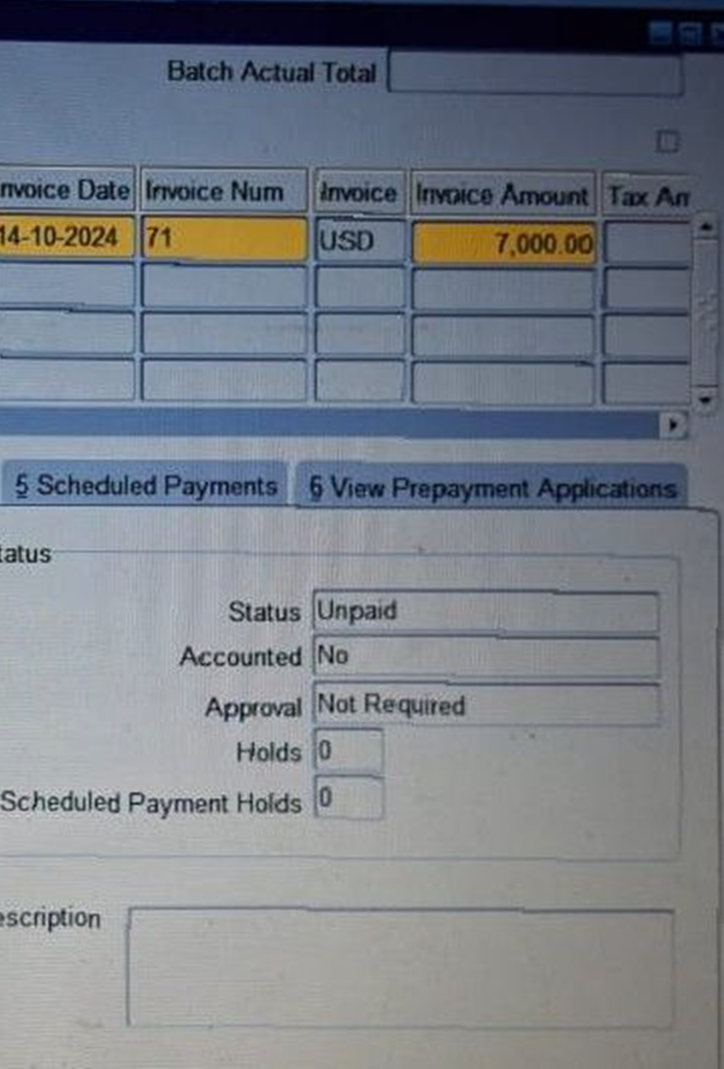
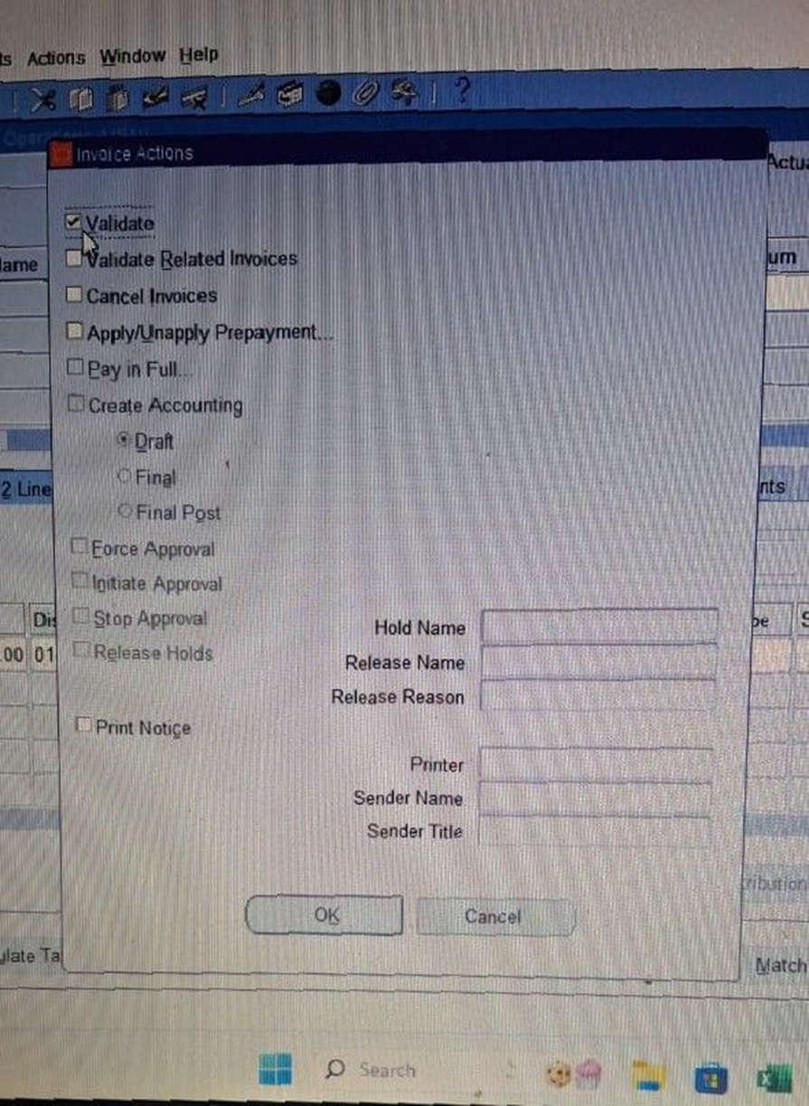
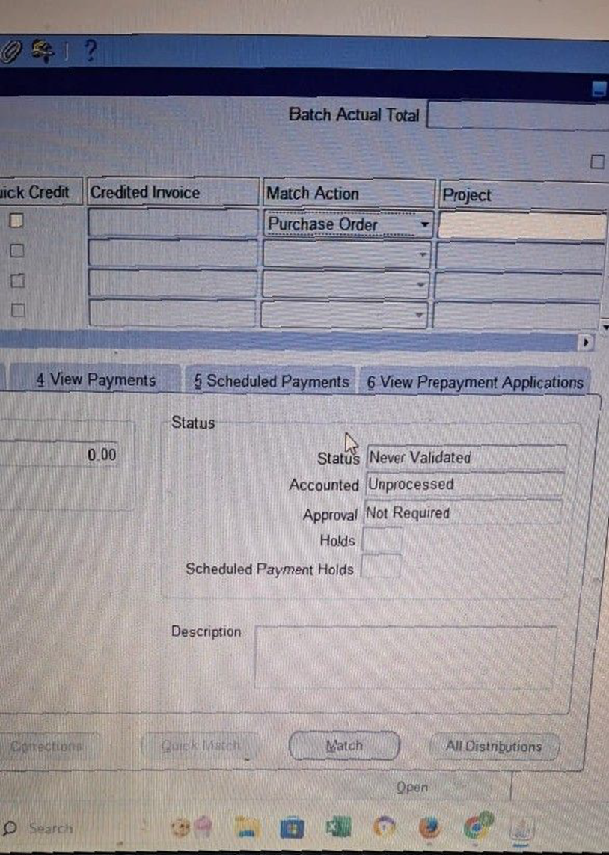
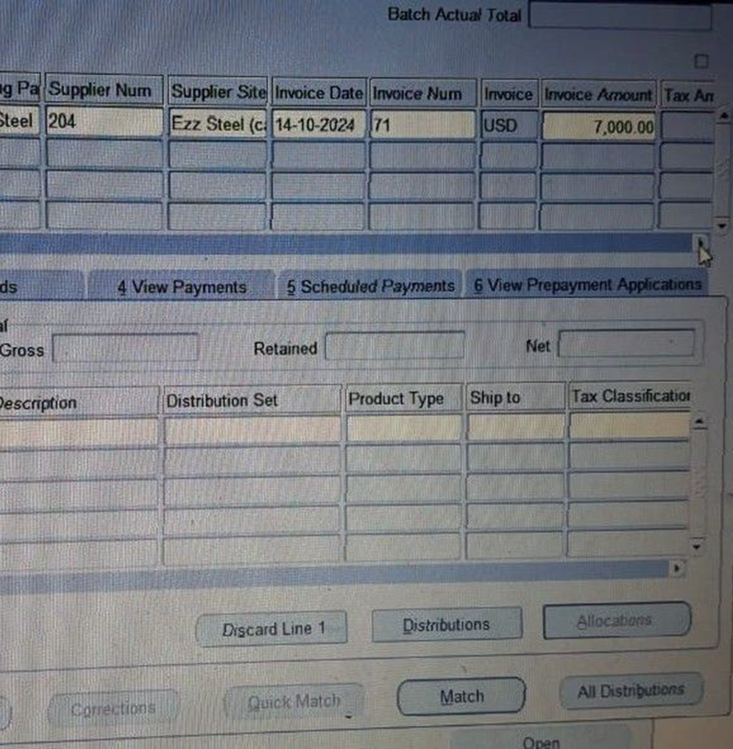
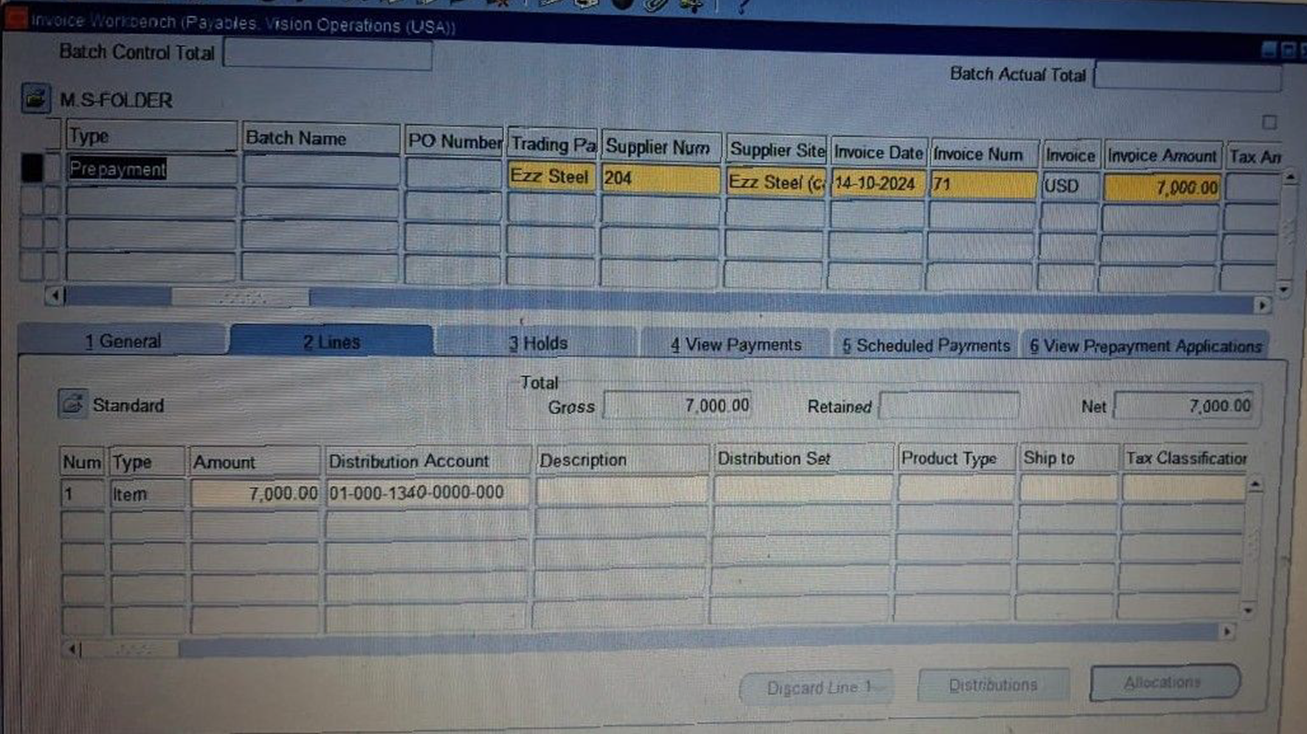
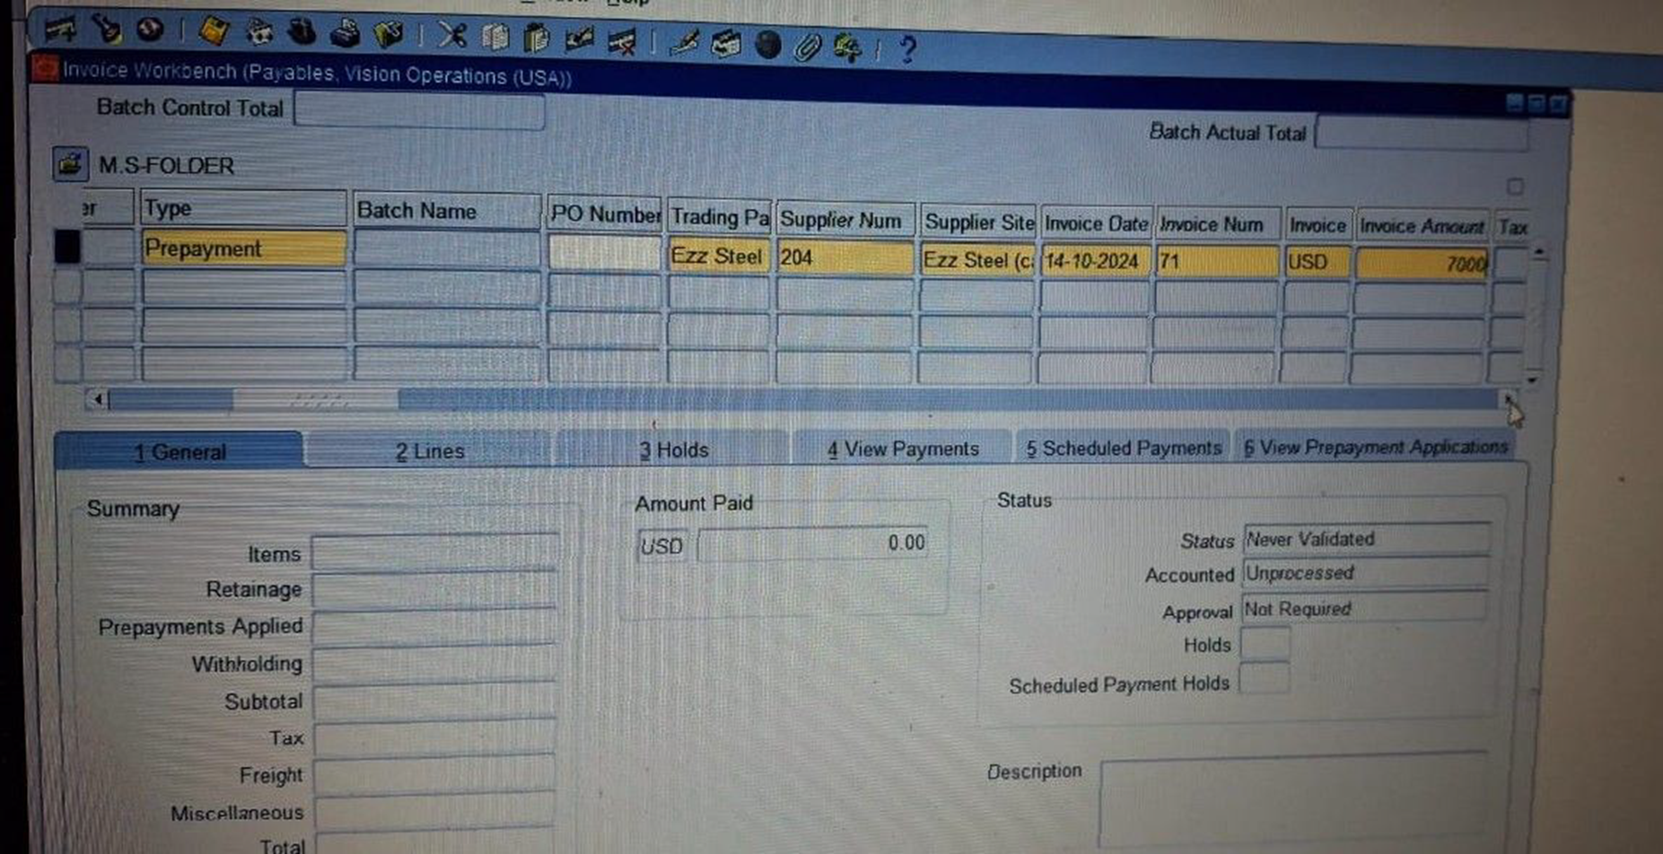
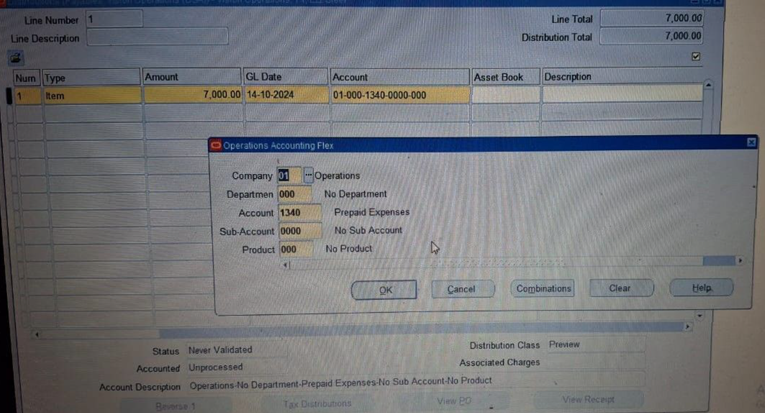
Create and Manage Supplier Invoices
Prepayment Invoice
Save and Click Match Button then match with a Purchase Order
Click on Match button
Match Action > Purchase Order > Match
Line > Distribution > Acc (Prepaid Expenses ) >Ok
Action > Validate
Status > Un paid
23

